Slide 1
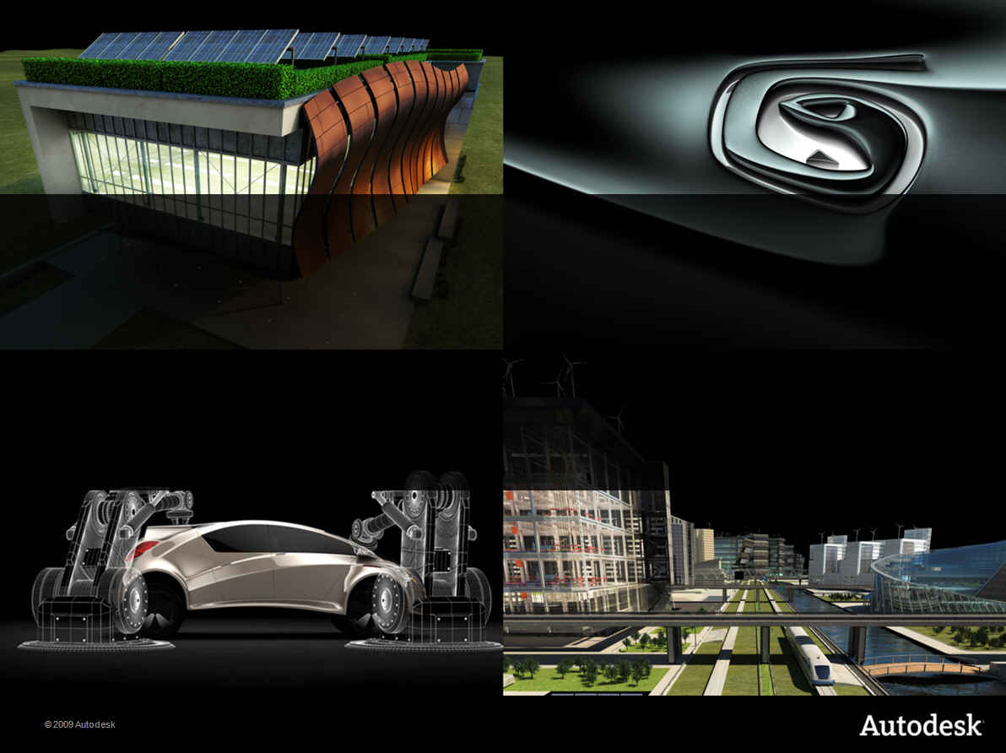
Developer Days Online
What’s New in Revit 2012 API
Saikat Bhattacharya
Developer Technical Services
® 2011 Autodesk Developer Network

Slide 2
This presentation…
From ADN Developer Days Conference
ADN member only conference
November/December last year
More than 20 cities worldwide
This recording is available to public

Slide 3
This presentation…
Posted at:
ADN Extranet
http://adn.autodesk.com
Revit > Knowledgebase > Whitepapers and Training Videos
Developer Center
API Training & Consulting > Schedule
http://www.autodesk.com/joinadn

Slide 4
Agenda
Revit 2012 Key Product Features
APIs
The Rice (must do)
The Wine (value add)
New SDK Samples

Slide 5
Agenda
Revit 2012 Key Product Features
APIs
The Rice (must do)
The Wine (value add)
New SDK Samples

Slide 6
Revit 2012 Themes
Construction Modelling
More detailed geometric information to manage construction workflows
Analysis and Visualisation
Detailed environmental and element relationship information
Display more types of analysis results
Large Team Workflow
Access to Worksharing information
Interoperability
Point clouds
Notes:
Concentrating on several items:
Continuing focus on construction, will benefit users working on building fabrication.
More extensions to analysis visualization – mostly on the API front.
Large teams, focusing on worksharing benefits for Revit 2012.
Given industry focus on construction and renovation, Revit 2012 will also focus on point clouds.
Focus on construction and in close sync with Analysis theme
Make more information of the model available to API users to enable better analysis and manipulate model appropriately for construction, cost analysis, or any other tasks which requires far more detailed understanding of the model.
In conjunction with worksharing features, we will have access to worksharing information – a highly requested feature.

Slide 7
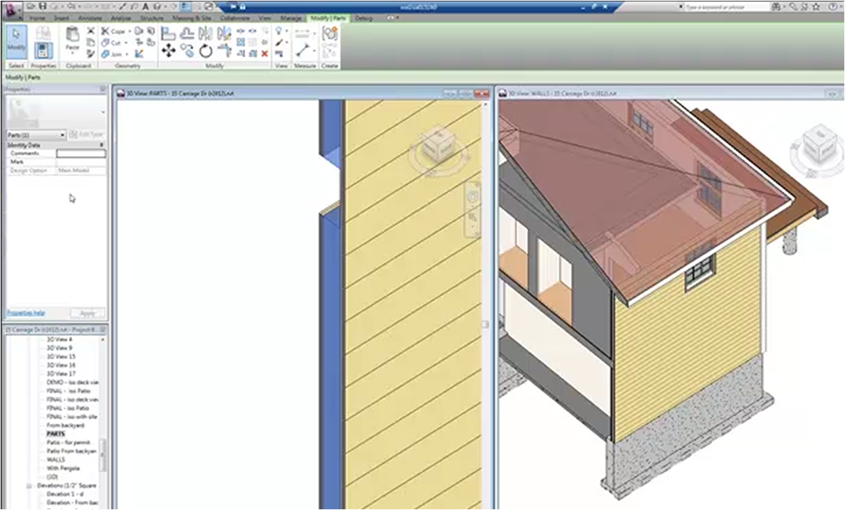
Revit 2012: Construction Modelling
Wall layers
Subdivision of elements – quantification, construction
Slabs, monolithic concrete objects – split into component pieces
Notes:
Subdivision of elements in the model for quantification and better understanding from construction point of view. This covers walls, slabs and other monolithic concrete objects. They can now be broken down into their component pieces. Also enable subdivision of monolithic concrete elements into parts which are in sync with the designed intent and construction workflow at site (since monolithic concrete elements cannot be delivered in whole piece at the site and need to be split into parts for assembly at site – this allows the splitting into parts).

Slide 8
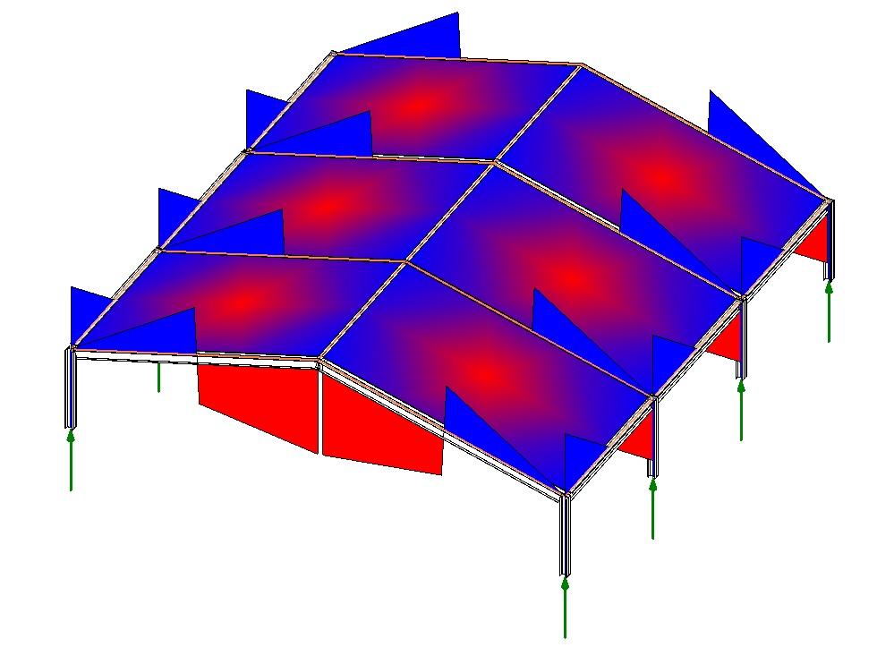
Revit 2012: Analysis Visualization
API feature enhancements
Vector analysis
Non-element solids
Notes:
This is an API feature providing various enhancements to show different kinds of visualization, e.g. vector analysis and other results painted on the model.
2011 added AVF, paint numerical results graphically on surfaces. Now extended to paint more flexibly, temporary graphics, display things that are not elements. Help test whether the invisible thing you made is really were you thought it was.

Slide 9
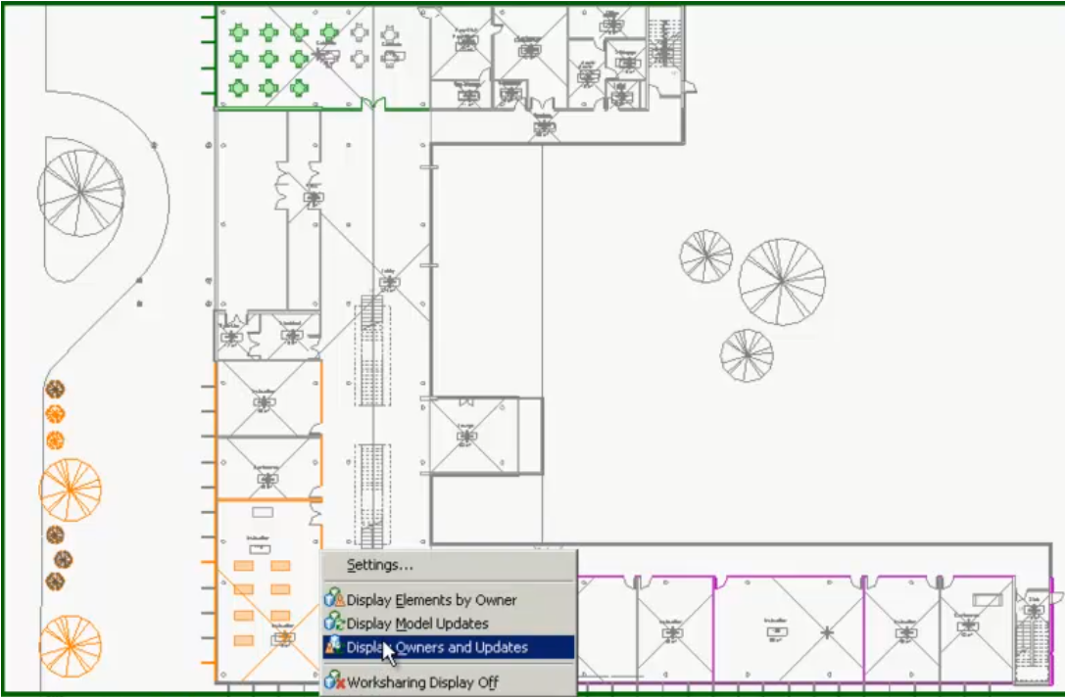
Revit 2012 – Worksharing
Who’s borrowing? Which elements? What changed?
Visualisation and color schema – to aid collaboration
Notes:
Revit knows a lot about who is borrowing which elements to work on in a collaborative work setup and on what has changed in the model since it was last saved. This release helps surface that information to the users so that users can make more intelligent decisions on when to sync to central, who owns which element in a given time in the model. Remove surprises for users when things change.

Slide 10
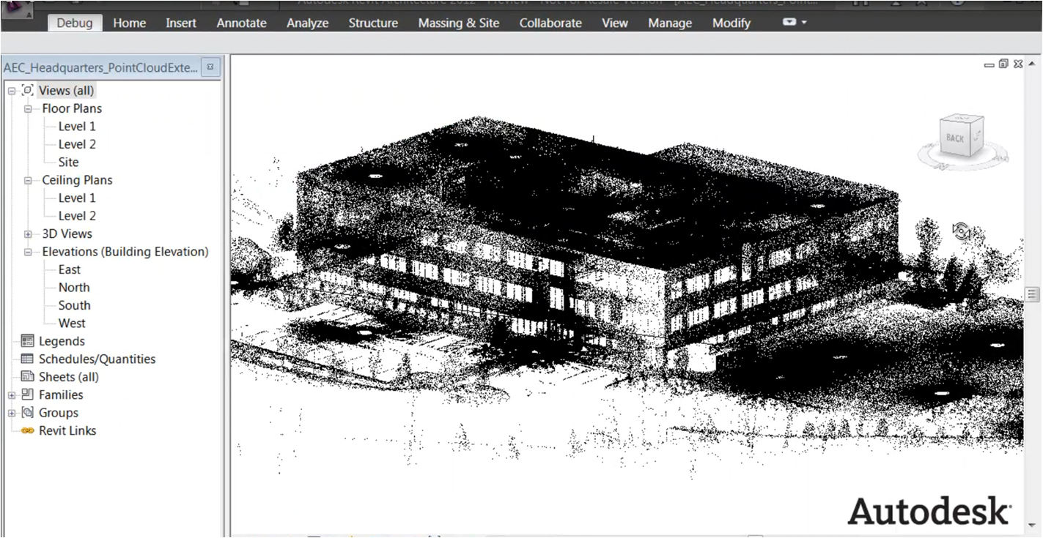
Revit 2012: Point Clouds
Field data, renovation
Challenges – large data, recognizing shapes
Multi-year project
Notes:
Focus to help users who are retrieving field data via various methods and translating it into a Revit model. Challenges in this process are both how to get points into Revit and how to recognize shapes. This will be a multi year endeavor and good progress has already been achieved in this release.

Slide 11
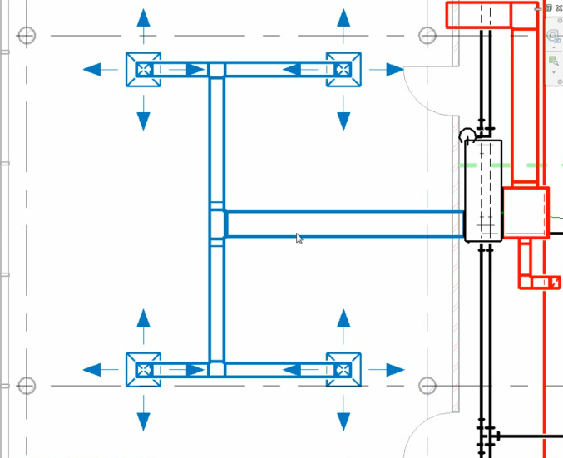
Revit 2012: Piping and Ducts
Place holder elements – well connected system without specific part info
Notes:
Continued significant investment in Revit MEP: piping, plumbing, ducts. Revit now provides the ability to define placeholder elements so that a system can be designed before one is completely sure of the design of the layout. A well connected system can be created which can then be elaborated in the final design at a later stage.

Slide 12
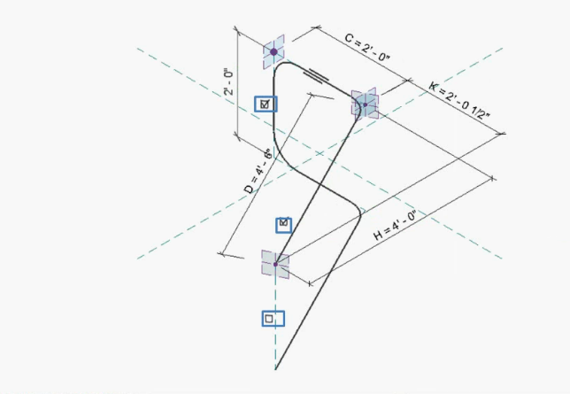
Revit 2012: Rebar Improvements
3D rebars – essential for multiple applications in building and civil
Notes:
RST rebar improvements: 3D rebar, critical for many different types of building, no bridges yet, 3D rebar is essential. Ability to make 3D rebars, essential for multiple application in building and civil structures.

Slide 13
Revit 2012 Product Feature Demos
Check out:
http://www.youtube.com/AutodeskBuilding
More to come!

Slide 14
Agenda
Revit 2012 Key Product Features
APIs
The Rice (must do)
The Wine (value add)
New SDK Samples

Slide 15


API’s and Porting
The Rice
Making sure your application runs
Steps to support the next release
The Wine
Opportunities to add value
Using the new features and APIs to increase the value of your and our products
Notes:
Now for the API: rice and wine, porting and value add. Some of the rice is actually wine as well, so some slides have both white bullet is rice, yellow is wine.

Slide 16
Agenda
Revit 2012 Key Product Features
APIs
The Rice (must do)
The Wine (value add)
New SDK Samples

Slide 17
The Rice
.NET Framework 4.0
.ini file deprecated
Vendor identification
Manual regeneration mode
Compound structure and wall sweeps
Line and fill patterns
Independent tag
Import and export APIs
Save and close API changes
Reference properties
Event changes
Move/Mirror/Rotate/Array changes
Structural analytical model
Rebar changes
Notes:
Some of the rice items also gives us the wine. The items have been color coded based on something that has to be done vs. something that you have to do but that also provides some new benefit.

Slide 18
.NET 4.0
Revit API enhanced to run with .NET 4.0 runtime
Use Visual Studio 2010 with framework target of .NET 3.5 or 4.0
Addins compiled with VS 2008 will run outside debug environment

Slide 19
Vendor ID
VendorId – RDS (Registered Developer Symbol) http://www.autodesk.com/symbreg
VendorDescription – optional
<?xml version="1.0" encoding="utf-8"?>
<RevitAddIns>
<AddIn Type="Application">
<Name>External Tool</Name>
<Assembly>TstIdling.dll</Assembly>
<ClientId>f50271c6-ef46-4df5-95a0-50fce5c389dc</ClientId>
<FullClassName>TestScript.CtrlApplication</FullClassName>
<VendorId>adsk</VendorId>
</AddIn>
<AddIn Type="Command">
<Assembly>TstIdling.dll</Assembly>
<ClientId>509083ba-68ef-4328-8155-1fcb4b6aa814</ClientId>
<FullClassName>TestScript.TriggerPnts_InEC</FullClassName>
<Text>TstNormalTriggerPnt</Text>
<Description>""</Description>
<VisibilityMode>AlwaysVisible</VisibilityMode>
<VendorId>adsk</VendorId>
</AddIn>
</RevitAddIns>
Notes:
Vendor id: manifest file mandatory property. The Vendor id should be a 4-character “prefix” registered with Autodesk as per Autodesk’s vendor Id Standard. 56000 possible ids.
VendorDescription: is user readable, unlike the id. And is optional. It will contain vendor’s legal name and other pertaining information.
This might be shown in pop-ups: error message says "please contact Xyz".

Slide 20
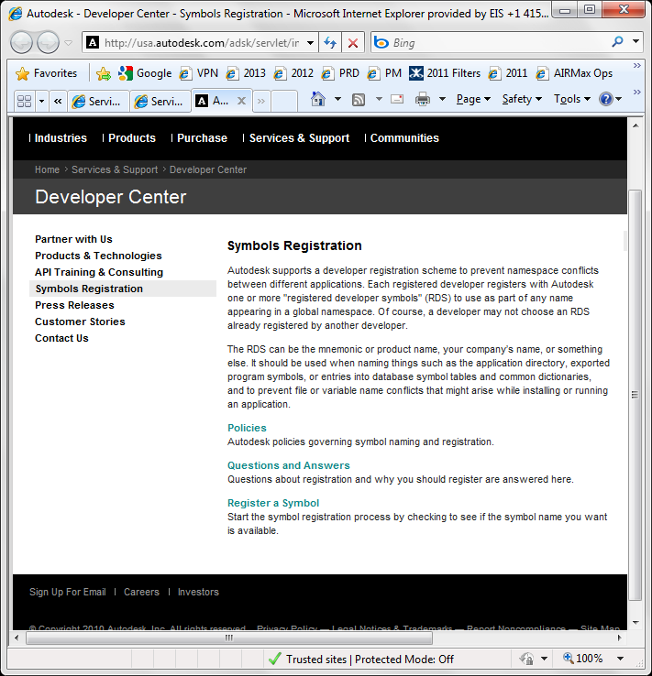
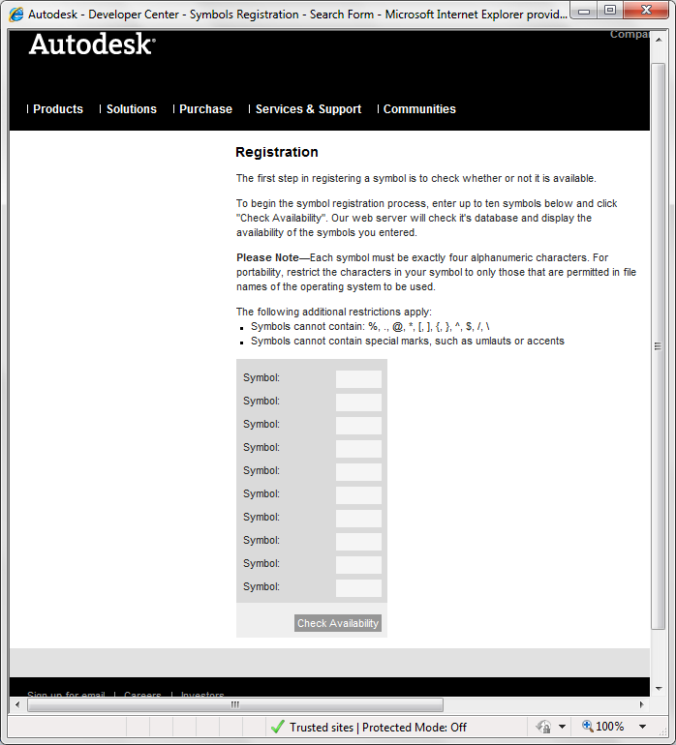
Vendor Identification

Slide 21
Regeneration Mode
Automatic regeneration mode removed
API expects code to be written with manual regeneration
Notes:
As was warned in Revit 2011, the automatic regeneration mode for external applications is being removed which means regen in the control of API users and is also entire API users responsibility. You have to notify Revit of regeneration after your work is done.

Slide 22
CompoundStructure and Wall Sweeps
Revit 2011 CompoundStructure was read-only
Revit 2012 CompoundStructure supports read and modifications of all properties
CompoundStructure.Layers property replaced with Get and Set Layers
HostObjAttributes.CompoundStructure replaced with Get and SetCompoundStructure methods
Access to vertical regions, wall sweeps and reveals
WallSweep class represents either standalone wall sweep/reveal, or part of compound structure
Notes:
New CompoundStructure API covers all data exposed in Revit UI. WallSweeps API covers sweeps inside CompoundStructure as well as standalone sweeps. CompoundStructure and Wall Sweeps have been read-only so far, there was nothing more that was possible with them. Now, modification is possible. If API developers have used some of these APIs before, then there are changes related to these but with these changes it provides lot more capability to manipulate these types of structures. For example now API users can quantify introduction of some kind of reveal of a different material.

Slide 23
Line and Fill Patterns
Line/FillPattern replaced with new classes
Previously represented both pattern and element containing it
APIs
Line/FillPattern – new
Line/FillPatternElement – new
Line/FillPattern.Create() – new
Settings.Line/FillPatterns - removed
Retrieve using filtered element collector or static methods on class
Notes:
LinePattern
The LinePattern class has been replaced. The old LinePattern class in the API represented both the line pattern itself and the element that contains it, and offered no details on the contents of the pattern beyond its name. The new classes available are:
LinePatternElement - an element that contains a line pattern
LinePattern - the line pattern. This class provides access to the pattern name and the list of segments that make up the pattern. The line segments define a repeating pattern of dashes and dots for the line pattern.
The method
LinePatternElement.Create()
offers the ability to add new LinePattern elements to the Revit database.
The property of the Settings class:
Settings.LinePatterns
has been removed. LinePatterns may be found by the following approaches:
Use of a FilteredElementCollector filtering on class LinePatternElement
Use of the static methods of LinePatternElement:
LinePatternElement.GetLinePattern(Document, ElementId)
LinePatternElement.GetLinePatternByName (Document, string)
FillPattern
The FillPattern class has been replaced. The old FillPattern class in the API represented both the fill pattern itself and the element that contains it, and offered no details on the contents of the pattern beyond its name. The new classes available are:
FillPatternElement - an element that contains a fill pattern
FillPattern - the fill pattern. This class provides access to the pattern name and the set of grids that make up the pattern.
FillGrid - a single fill pattern grid, described in the two dimensions of a face.
The method
FillPatternElement.Create()
offers the ability to add new FillPattern elements to the Revit database.
The property of the Settings class:
Settings.FillPatterns
has been removed. FillPatterns may be found by the following approaches:
Use of a FilteredElementCollector filtering on class FillPatternElement
Use of the static methods of FillPatternElement:
FillPatternElement.GetFillPattern(Document, ElementId)
FillPatternElement.GetFillPatternByName (Document, string)

Slide 24
IndependentTag
Renamed
Leader -> HasLeader
LeaderMode -> LeaderEndCondition
New
TaggedElementId
TaggedLocalElementId
GetTaggedLocalElement()
IsOrphaned
Notes:
IndependentTag
A good portion of the IndependentTag class and related classes have been renovated.
Leader has been renamed HasLeader
LeaderMode has been renamed LeaderEndCondition, and the members of the LeaderEndCondition enum have been renamed
A new method CanLeaderEndConditionBeAssigned() determines if the LeaderEndCondition can be set.
TagMode has been replaced by multiple properties: IsMaterialTag, IsMulticategoryTag.
Members of the TagOrientation enum have been renamed.
Some new members were added to determine the elements referenced by the tag:
New property TaggedElementId - provides the id of the element referenced by the tag.
New property TaggedLocalElementId - provides the id of a linked element reference by the tag.
New method GetTaggedLocalElement() - returns the handle of the element reference by the tag.
New property IsOrphaned - Orphans are those tags that are associated with an instance of a linked Revit file but have no host element. Tags become orphaned when the element they were tagging was deleted from the link.

Slide 25
Import and Export APIs
Method signatures changed
No use of active view, can be passed as input
Some export formats require non-empty view set
Export
Typical signature
bool Export( string folder, string name, ViewSet, DGNExportOptions );
3D view must be provided for
bool Export( string folder, string name, View3D, ViewPlan, BuildingSiteExportOptions );
Import
View property removed from DWGImportOptions
bool Import( string file, DWGImportOptions, View, out Element );
Notes:
Import and Export APIs now require view inputs
The import and export APIs no longer have special argument combinations which permit use of the "active view". This has been done to make the API less dependent on the active view. If you wish to export from or import to the active view, you must obtain it directly and pass it as input to the method. But if required, this rice change will allow API users to provide an explicit named view rather than being limited to a active view.
For the following APIs, a non-empty ViewSet must be provided:
bool Export (string folder, string name, ViewSet views, DGNExportOptions options);
bool Export (string folder, string name, ViewSet views, DWGExportOptions options);
bool Export (string folder, string name, ViewSet views, DXFExportOptions options);
bool Export (string folder, string name, ViewSet views, SATExportOptions options);
bool Export (string folder, string name, ViewSet views, DWFExportOptions options);
bool Export (string folder, string name, ViewSet views, DWFXExportOptions options);
bool Export (string folder, string name, ViewSet views, FBXExportOptions options);
For the following API, a 3D view must be provided:
bool Export(string folder, string name, View3D view, ViewPlan grossAreaPlan, BuildingSiteExportOptions options);
For import APIs, the 'View' property has been removed from the DWGImportOptions and ImageImportOptions. Instead, a new required argument has been added for the following APIs:
bool Import (string file, DWGImportOptions options, View view, out Element element);
bool Import (string file, ImageImportOptions options, View view, out Element element);
bool Link (string file, DWGImportOptions options, View view, out Element element);

Slide 26
Save and Close API changes
Document.Close()
Document.Close(bool saveModified)
Document.Save()
Document.Save(SaveOptions options)
Set view for file preview
Document.SaveAs(string filename)
Document.SaveAs(filename, options)
Set view for file preview
UIDocument.SaveAndClose()
UIDocument.SaveAs()
DB vs. UI – logical split
Notes:
This is done to provide a logical split between DB-only and UI functionality. UIDocument methods can pop up dialogs to the user (prompts about whether or not to save, and/or prompts for where to save the file to). DB-level methods do not show dialogs, options used are explicitly defined as defaults or input options.
This also adds the ability to set a preview view id during save (new functionality). The id is temporary just for one save operation. In 2011 UR2, we added DocumentPreviewSettings which allow you to set the preview id for the document permanently. Again transitioning towards internal API style, open and close changes, some additional capabilities added.
Save and Close API changes
Document.Close()
Document.Close(bool saveModified)
The behavior of these methods has been changed. Previously, they would prompt the interactive user to pick a target path name if the document's path name was not already set, or if the target file was read-only. Now they will throw an exception if the document's path name is not yet set, or if the saving target file is read-only.
Document.Save()
The behavior of this method has been changed. Previously, it would prompt the interactive user to pick a target path name if the document's path name was not already set, or if the target file was read-only. Now it will throw an exception if the document's path name is not set yet. In this case, it needs to be first saved using the SaveAs method instead, or when the target file is read-only.
Document.Save(SaveOptions options)
This new method behaves identically to Document.Save(), but allows you to specify a temporary id to use to generate the file preview.
Document.SaveAs(string fileName)
Document.SaveAs(string fileName, bool changeDocumentFilename)
The behavior of these methods has been changed. Previously, they would prompt the user before overwriting another file. Now an exception will be thrown in that situation.
Document.SaveAs(string fileName, SaveAsOptions options)
This new method allows you to save a document, and encapsulates the options to rename the document in session, overwrite an existing file (if it exists), and temporarily assign a view id to use to generate the file preview.
UIDocument.SaveAndClose()
This new method closes the document after saving it. If the document's path name has not been set the "Save As" dialog will be shown to the Revit user to set its name and location.
UIDocument.SaveAs()
This new method saves the document to a file name and path obtained from the Revit user (via the "Save As" dialog).

Slide 27
Reference properties
Renovated to match the native Revit class
Automatically generated code
2011 – fully populated (not automatic, obsolete)
2012 – not populated
Document.FindReferencesByDirection returns Reference
New method FindReferencesWithContextByDirection returns fully populated information
Reference Property | Replacement
.Element | .ElementId
.GeometryObject | Element.GetGeometryObjectFromReference(Reference)
Notes:
This is done because the Reference class in the API was out-of-alignment with the native Revit class it represents, making it hard for automatic code generation. The extra data carried by the Reference class cannot be populated automatically. Instead, you can use the Reference to find the Element, GeometryObject from the document. FindReferencesWithContextByDirection preserves the special outputs from FindReferencesByDirection using the modified Reference semantics.
Reference properties
The Reference class is being renovated to be more closely aligned with the native Revit class it wraps. Because of this change, References will no longer carry information on the document, element, or geometry object it was obtained from. The following table lists the replacement APIs for the Reference properties:
Reference property : Replacement
.Element : .ElementId or Document.GetElement(Reference)
.GeometryObject : Element.GetGeometryObjectFromReference(Reference)
.Transform : ReferenceWithContext.GetInstanceTransform() (see below)
.ProximityParameter : ReferenceWithContext.ProximityParameter (see below)
.ElementReferenceType : Unchanged
.GlobalPoint : Unchanged
.UVPoint : Unchanged
The method
Document.FindReferencesByDirection()
is affected most by this change. The method was the only method to populate the Transform and ProximityParameter properties of Reference. You should switch to the replacement method:
Document.FindReferencesWithContextByDirection()
This replacement method returns a list of ReferenceWithContext objects, containing the Reference plus additional members:
ReferenceWithContext.ProximityParameter
ReferenceWithContext.GetInstanceTransform()
Note that methods which existed in Revit 2011 and earlier will continue in this release to return a fully populated Reference object (it is not necessary to change code dealing with these methods). However, methods added in Revit 2012 may not return a fully populated Reference handle and will need to be parsed using the replacement methods above. Also, affected members have been marked obsolete and planned to be removed in a future release.

Slide 28
Event changes
Event argument changes (from prop to method)
Cancel -> Cancel(), IsCancelled()
ImportedInstance -> ImportedInstanceId
PrintedViews -> GetPrintedViewElementIds()
FailedViews -> GetFailedViewElementIds()
Views -> GetViewElementIds()
Sender object type changed
ApplicationClosing event sender is now UIControlledAppilcation object
For others, it is UIApplication
Alignment to the code generator
DB level app for DB level event/updaters
Notes:
Many of these changes are alignment to the output of our code generator; all events are now generated. In some cases we are still tweaking the code generator and may restore some of these changes before Beta. The sender object change represented an oversight; of course UI events should receive the UIApplication object as the sender, not a DB-level object.

Slide 29
Move and Mirror changes
New ElementTransformUtils class
Document.Move replaced by
ElementTransformUtils.MoveElements(
doc, ICollection<ElementId>, XYZ );
ElementTransformUtils.MoveElement(
doc, ElementId, XYZ );
Document.Mirror replaced by
ElementTransformUtils.MirrorElements(
doc, ICollection<ElementId>, Plane );
ElementTransformUtils.MirrorElement(
doc, ElementId, Plane );
Add new functionality
Align native and API code
Remove implicit dependency on active view
Notes:
These renovations are to:
Remove implicit dependency on ActiveView
Gain new functionality
Better align native and API code
With Mirror - These new methods allow you to mirror one or more elements directly about a geometric plane which you may construct directly. Previously the Document.Mirror() methods required you to obtain a reference to an actual plane, or implicitly used the active view to calculate the mirror plane.

Slide 30
Rotate and Array changes
Document.Rotate replaced by
ElementTransformUtils.RotateElements(
doc, ICollection<ElementId>, Line, double );
ElementTransformUtils.RotateElement(
doc, ElementId, Line, double );
Document.Array replaced by
LinearArray.Create( doc, View, ICollection<ElementId>,
int, XYZ, ArrayAnchorMember );
LinearArray.Create( doc, View, ElementId,
int, XYZ, ArrayAnchorMember );
RadialArray.Create( doc, View, ICollection<ElementId>,
int, Line, double, ArrayAnchorMember );
RadialArray.Create( doc, View, ElementId,
int, Line, double, ArrayAnchorMember );
Notes:
These renovations are to:
Remove implicit dependency on ActiveView
Gain new functionality
Better align native and API code

Slide 31
Materials Renovation
Existing materials classes deprecated
New materials classes include
Dedicated property sets
Structural
Appearance
New material element
Material description
In line with internal code
Notes:
This is not in any release that is out yet and hopefully in next one. Material changes to bring something in line with internal code which is changing and also open a lot of opportunities in future around physical material. Will start small with changes with structural and appearances but will scale it up slowly to help work on sustainability, cost estimation, etc. The attempt is to build an infrastructure that can grow with these uses in logical fashion. There will be some rice changes at this point when they are released.
The material renovation will continue further past the present release. Many interesting areas of use, and put in robust support for things beyond visual support. The Revit model behaviour is influenced by material properties. Working with manufacturing on this: engineering properties. For instance, in architecture, a window: argon glass, aluminum, rubber ... how will the window behave?

Slide 32
Rebar changes
Several indexed properties replaced by methods
Several method replacements due to general cleanup, adherence to API and .NET standards, and changes to methodology for how rebar shapes are defined
New rebar cover methods
GetExposedFaces()
GetCommonCoverType()
SetCommonCoverType(CoverType)
GetRebarsInHost()
GetAreaReinforcementsInHost()
GetPathReinforcementsInHost()
Notes:
Standardizing interfaces. Number of changes to Rebar Host data but also some new rebar cover methods to help better understand the area between the rebar and outer surface of concrete. Rebar is the biggest example of aligning add-on API with internal Revit classes. The internal developer creates API also. Lots of changes here, details covered in docs. Follows proper API and .NET standards. Lots of new properties and methods. 3d rebar support and corbel support. The assembly feature that you saw is a precast workflow. We have done lots of work around precast. Corbel is one of those critical things.

Slide 33
Agenda
Revit 2012 Key Product Features
APIs
The Rice (must do)
The Wine (value add)
New SDK Samples

Slide 34
The Wine
Open and Activate Document
Setting Active View
Custom Ribbon Tab Management
Worksharing
Geometry
Analysis of Room and Space 3D geometry
Detailed energy analysis
Conceptual energy analysis
Analysis Visualization Framework enhancements
MEP API enhancements
Rebar enhancements
Construction modeling
Point Clouds
Extensible Storage
And more!
Notes:
Here comes a bunch of really longtime requests, things that people wanted to do for a long time.

Slide 35
Open and Activate Document
UIApplication.OpenAndActivateDocument
Opens a Revit document and makes it active with its default view displayed
Cannot be called
when there is an open transaction in the currently active document
during execution of any event handler
Notes:
Long time request from Revit plug-in developers – you will now be able to open and make active the document of your choice. Some minor restrictions as shows in slide – cannot open in open transaction and cannot open in response to an event.

Slide 36
Set Active View
UIDocument.ActiveView
Query and set the currently active view of the currently active document
Document must
be the active document
not be in read-only state
not be inside a transaction
Set cannot be used during
ViewChanging and ViewChanged events
any pre-action event, e.g. DocumentSaving, DocumentExporting, etc.
Notes:
Again a strong request from API users – ability to set the active view with some obvious restrictions as shown.

Slide 37
Custom Ribbon Tab
UIApplication.CreateRibbonTab
UIApplication.CreateRibbonPanel(string, string)
UIApplication.GetRibbonPanels(string)
Add new tabs to the right of the ribbon
Tabs will display in the order added
Limit of 20 total custom tabs
Please exercise restraint!
Notes:
Popular request – now we can create our own tabs. Exercise restraint since there is limited space in the user interface with existing Revit tabs still discernible. The limit has been set to 20 custom tabs – these tabs will appear to the right of the existing Revit tabs – even right of Add-In tab. You still have the add-ins and analyse tab.

Slide 38
Worksharing – Comprehensive Read API
List of Worksets
List of Elements in a Workset
Determine borrower of an Element
Determine Element Workset Membership
Determine and Control Workset Visibility
Determine whether an Element is out of date
Control Worksharing View Mode display
Initial project view setting
Central Model Update Event
Filtering e.g., FilteredWorksetCollector
Notes:
Again a popular request: now we can access the list of worksets, find out what elements are in the workset, who's borrowed it, has the element gone out of date with Central. All this provides more finesse to what you need to react to – for example a borrowed element might have been altered already and need not be monitored via events.
In future pre-release build, there is some infrastructure being added to enable users to ask for edit elements that someone else has checked out.
API around new worksharing functionality planned for later (colour coding by element etc.)
Not all existing functionality exposed: operations such as Open Latest need more untangling before exposure.

Slide 39
Geometry
Get original geometry of a FamilyInstance
Before cuts/joins/openings are applied
Extrusion analysis of a solid
Obtain silhouette of a solid as projected onto a plane
Obtain faces which do not align with silhouette
Obtain elements which created solid faces
Non-element geometry creation
Create solids for use in AVF, geometry analysis, and more
Boolean operations
Intersect/join/subtract two solids to form a new solid
Results are non-element geometry, but input can be from elements
HostObject – get top, bottom, side faces
FamilyInstance – get host face
Proximity Detection filters
Element filtering using “InterferenceReport”
Element filtering intersecting with non-element solid geometry
Notes:
Major focus. A lot of effort put in to provide more information on Revit element geometry – thus aiming to help API users who do not get to see the elements unlike the Revit users who can see it from the UI. Access the beam and column geometry before the fitting and joining happens in the model which is done by Revit. Further access to silhouette of a solid, obtain faces which are not aligned with Silhouette and obtain elements which created solid faces. So lot of analysis is available now on solids which was not possible until now. This should help understand the model as a visual observer.
Non element geometry creation – API users can create geometry that is not an element if you want to make it part of analysis by introducing it into the model. New APIs should be helpful in calculating proximity of elements.
From Host object, we can get the top, bottom and side faces of it from the family instance’s host object. This also helps in getting the interference report of two elements and also helps can create own shapes and calculate intersection of the shape with the element in the model.
Minor additions
Little more safety around element geometry so that API users don’t get information that is incorrect when accessing geometry of a given element.
Should be overall helpful since it will provide access to information from outside like face regions, which we could not get which was the split face of a wall and curve representations of the edge instead
Also provides method to calculate centroid which is as accurate as what Revit reports.
GetTransformed is helpful when moving elements around in the model.

Slide 40
Room and Space Geometry
SpatialElementGeometryCalculator class CalculateSpatialElementGeometry method
Compute and return the 3D geometry of the input spatial element with information about the elements forming the element boundary
SpatialElementGeometryResults
SpatialElementBoundarySubface
SpatialElementBoundaryOptions
Boundary options
Finish face
Object centerlines
Notes:
We can now get the 3D geometry of spatial elements like rooms and spaces. It provides access to elements which form the boundary of the rooms and for those who needs fine-grained information of the geometry of the room. You can now access the detailed geometry of the elements that form the boundary of the rooms. Until now we were only able to read the general shape of the room – now we can associate that shape with the elements that form the boundary. One of the existing samples, RoofsRooms, which used 300 lines of code to find out if the top boundary of the room intersected the roof or not, has now reduced to 30-40 lines of code.

Slide 41
Conceptual Energy Analysis
Already available in 2011 Subscription Pack
New classes in Autodesk.Revit.DB.Analysis namespace
ConceptualConstructionType
ConceptualSurfaceType
MassEnergyAnalyticalModel
MassLevelData
MassSurfaceData
MassZone
Provide access to the elements and objects created by Revit to perform energy analyses on conceptual design models
Export( MassGBXmlExportOptions )
Notes:
This became available in the subscription 2011 release of Revit which included the subscription energy analysis add-on. It uses the CEA API, which provides information that Revit uses for analytical conclusions.

Slide 42
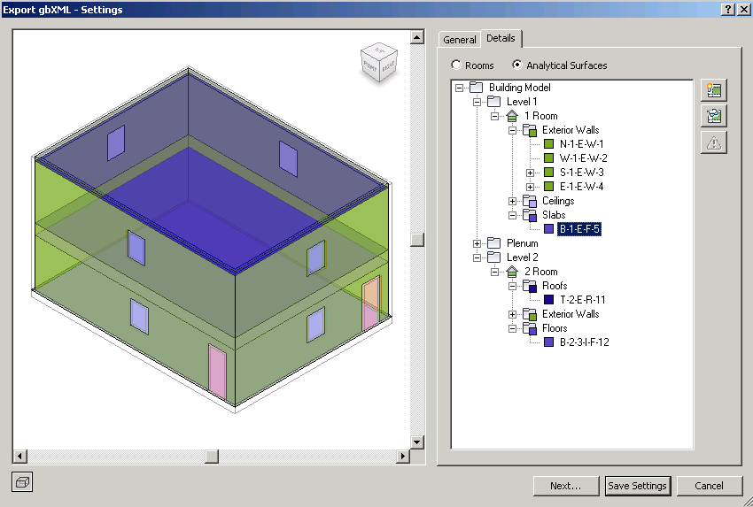
Detailed Energy Analytical Model
More API access for 3rd party
EnergyAnalysisDetailModel.create() opening/space/surface
Obtain and analyze the contents of a project's detailed energy model, as seen in the Export to gbXML and the Heating and Cooling Loads features
Produce an analytical thermal model from the physical model of a building. The analytical thermal model is composed of spaces, zones and planar surfaces that represent the actual volumetric elements of the building.
Notes:
This enables API users to access the energy model that Revit uses and exports to gbXML. If you are interested in alternate ways of analyzing this information, you can do that more elaborately – attempt here is to open this up for API users as much as is possible to enable creation of more sustainability applications.

Slide 43
Analysis Visualization Framework
Improved to support multiple analysis results in the same view simultaneously
New classes
AnalysisResultsSchema – store meta data
AnalysisDisplayDiagramSettings
AnalysisDisplayVectorSettings
New methods on SpatialFieldManager to register and access results meta-data
Notes:
Improvements in AVF – we are now able to display vectors along with the AVF. This will open up new type of analyses display. So in a sense it is one step short of showing computational fluid dynamics results except that there is no animation yet.

Slide 44
Rebar changes
3D Rebar Support
RebarShapeMultiplanarDefinition
New RebarShape methods:
getMultiplanarDefinition()
RebarBendData
Corbels Support
New category: “Structural Connection”
Host rebar
Autojoin to columns and walls
Manual join to other concrete elements
Notes:
Revit 2012 provides 3D Rebar support with definition for multi planar rebar and with some additional pre-release build information provided on how the rebars are bent and centerline information. Additionally, now there is support for corbels. These are items that help in hosting rebars. API team is making investment with pre-cast construction and is part of the API to support that.

Slide 45
MEP API, Duct and Pipe Insulation
Placeholder ducts and pipes
Identify, create, and convert placeholders to physical elements
PipeSettings, PipeSizeSettings
Read and write access to the plumbing settings governing pipe sizes in Revit MEP
DuctInsulation, PipeInsulation, DuctLining
Read, write and create access to new procedural insulation and lining features
Notes:
MEP elements are currently modeled three times over – the ducts themselves, an internal lining, and the external insulation. This has been changed in Revit to be procedural and provides classes to manage insulation and lining.

Slide 46
Construction Modeling
Assemblies
Put items together
For scheduling and shop drawing creation
Creation
Analysis
Modification
Shop Drawings
Isolate any group of elements
Creation
Part
Analysis
Create
Modification
Notes:
New functionality in Revit 2012 allows elements to be divided into sub-parts, collected into assemblies, and displayed in special assembly views.
A concept of construction modelling is assembly, an abstract way to think about putting items together as an assembly. This API helps select arbitrary set of elements and tell Revit that this is an assembly following which these can be used for scheduling and creation of shop drawings. The use case for this starts with pre-cast columns and some items associated with this column. You can link them all together as an assembly and schedule them as part of larger whole. This is not limited to structural elements and can be used for any group of elements which needs to be isolated to create shop drawings. This release will also have the ability to split and study elements into parts for analyzing and studying them with the API.

Slide 47
Point Cloud API
Engine API for Point Cloud Generation
Register Point Cloud file extension
Provide points to Revit for rendering
Client API for Point Cloud Consumption
Create new Point Cloud instances
Read & Filter Points
Control Point Cloud highlighting
Point Set Selection
Notes:
The client API is capable of working with point cloud instances within Revit (creating them, manipulating their properties like highlighting, selecting sub-sets of overall points, and reading the points found matching a given volumetric filter).
If you want to use your own point cloud engine and process your own file formats which are not supported, you will be able to hook it up to provide points to Revit for the on-screen rendering for the user to see. The engine API is capable of supplying points in a point cloud to Revit.

Slide 48
Extensible Storage
Create schemas for data storage
Data Types
Boolean, String, Int, Double
XYZ, UV
ElementId
Containers (Arrays, Maps)
Nested Schemas
Read and assign application-owned data to specific elements
Notes:
The Revit API now allows you to create your own class-like Schema data structures and attach instances of them to any Element in a Revit model. This functionality can be used to replace the technique of storing data in hidden shared parameters. Schema-based data is saved with the Revit model and allows for higher-level, metadata-enhanced, object-oriented data structures. Schema data can be configured to be readable and/or writable to all users, just a specific application vendor, or just a specific application from a vendor.

Slide 49
Linked Models
ExternalFileReference
Path and type information for an external file
ExternalFileUtils
Find all external file references
Get the external file reference from an element
Determine whether an element is an external file reference
RevitLinkType
An element representing a Revit file linked into a Revit project
CADLinkType
An element representing a DWG drawing
IsImport distinguishes between links or imports
ModelPath
File path to local, network or Revit Server
TransmissionData
Examine the external file data in a closed Revit document, and to modify path and load-state information for that data
Notes:
This is in connection with the large team workflow initiative, where worksharing is important and also linked models are major part of it. Now you can find external file references, trace the file path of external files and understand the load state in a Revit session. Various other pieces which help identify if a file is imported or merely linked, and different kinds of links – Revit models, CAD models, and finding the paths.

Slide 50
Performance Advisor API
Issue warnings for elements or settings that may cause performance degradation or affect model performance
PerformanceAdvisor
Access built-in Revit rules
Add/remove custom rules
Execute any combination of rules for a given model
IPerformanceAdvisorRule
Define a custom rule
Notes:
This is for API developers – provides opportunity for developers to introduce rules around performance to advise users of changes they would want to make. There will be some rules in Revit when it ships that API users can use, but there might be additional ones that API users might want to add. This is not a corrective action but it can advise users based on context e.g. saying your family has 12000 elements and it might be too many! API users can also analyze results from the adviser based on areas of interest regarding API users rules.

Slide 51
Performance Advisor
IPerformanceAdviserRule
GetName()
GetDescription()
InitCheck()
FinalizeCheck()
WillCheckElements()
GetElementFilter()
ExecuteElementCheck()
PerformanceAdvisor
AddRule()
DeleteRule()
GetNumberOfRules()
GetRule()
SetRuleDisabled
IsRuleDisabled
ExecuteRules
Potential problems reported by FailureMessage(s)

Slide 52
And much more …
Adaptive Components
IFC Document Open
FamilyParameter.GUID property
Identify Shared Parameters
Copy Element
Copy and translate (copy + move)
Workplane Flip for Family Instances
Face-hosted family manipulation
Disallow Wall End Joins
Element Pinned
And more!
Notes:
In Revit 2011, we introduced a number of conceptual modelling enhancements – putting in adaptive components and now we have API access to it.
We are also building the IFC export on top of the API as discussed before, we now have a function that will allow API users to trigger an IFC document open – especially for applications used in EU which do a considerable amount of IFC exchange, you can now start automating the document open.
Helps identify if the parameter is family parameter is a shared parameter and if it is, then access the GUID
Now possible to copy and move an element
Workplane manipulation possible in project editor mode – works on face hosted family instances and helps flip the work plane and this requested has been implemented for structural connectors not being able to be placed properly without work plane flipping feature.
Lot of requests for asking Revit to not join walls for various workflows like having a gap in a wall join.
Ability to pin/unpin elements or understand their state.

Slide 53
Agenda
Revit 2012 Key Product Features
APIs
The Rice (must do)
The Wine (value add)
New SDK Samples

Slide 54
API Demo < hide slides >
DevDays2010
AddRibbonTabs
Geometry2012
RoofsRooms
AdaptiveComponent
ExtensibleStorageDemo
MepPlaceholders

Slide 55
New SDK Samples
< List of new SDK samples comes here>

Slide 56
Developer Days Online
What’s New in Revit 2012 API
Saikat Bhattacharya
Developer Technical Services
® 2011 Autodesk Developer Network

